Slide 1

CSS: Venturing Beyond ‘It Works’
Writing Sane and Flexible CSS that Makes Sense to Future You

Slide 2

State of the CSS Address

Slide 3

Current State
3 Style Guides/Themes
myUSCIS Style Guide
US Style Guide
SVS Style Guide
Selectors with same purpose (i.e., .float-right and .to-right)
Selectors that are too specific (i.e., .p-no-margin-top)

Slide 4
Current State
Confusing file structure, resulting in uncertainty over what’s already been written
Things work, but it’s at the expense of repeated code
Lots of unused code pulling from myUSCIS

Slide 5
We Need…
A sane environment that is accessible to lots of people
To tame and manage source order
To create a place for everything to live (new and old)
To reduce waste and redundancy (code bloat)

Slide 6
Our Focus
Who’s Fault: CSS or Us?
Keeping Things Tidy with the 7-1 Pattern
Class Naming: Specificity
Nesting: Keeping Things Readable
Syntax, Commenting, and the Death of !important

Slide 7
Problems with CSS: CSS’ Fault vs. Our Fault

Slide 8
CSS’ Fault
The cascade and inheritance
Highly dependent on source order
Lots of gotchas
Specificity

Slide 9

Our Fault
Lack of documentation
Mixture of abilities
Different styles, preferences, ways of working
Not looking to see/being aware of what already exists
Adding new styles to the end of stylesheets

Slide 10
Inheritance and source order

Slide 11
Each piece of CSS needs a knowledge of what came before it and what might come after it – a.k.a dependencies

Slide 12
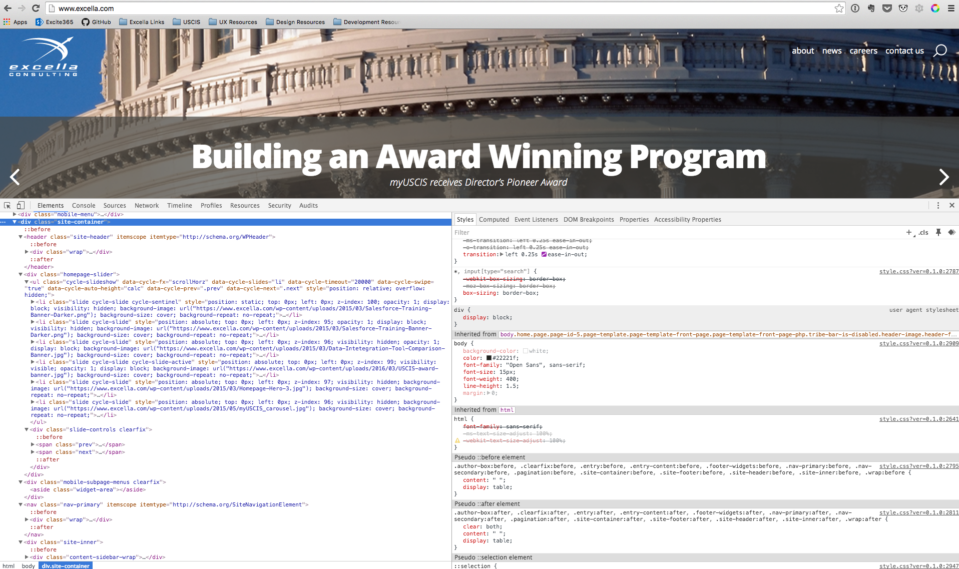

Slide 13
CSS is one giant dependency tree. We need a way to manage this dependency at a very low level.

Slide 14

Ways of ordering stylesheets
Mirror the web page
Thematic chunks – typography, forms, buttons, etc
Just stick it at the end of the stylesheet (and regret it later)
SVS Method: Thematic Chunks (more to come on this)

Slide 15
Ordering Stylesheets (Gone Bad)
Undoing the CSS: writing more CSS in order to undo the other CSS
Poor source order coupled with inherited/inheriting styles can lead to a lot of waste and/or redundancy (code bloat)

Slide 16
Keep things tidy. Use thematic chunks.

Slide 17
Break out like-styles and @import them into a main file. Think of the main file as purely a table of contents. SVS Adaptation: Our main file is all.scss

Slide 18
ONE FILE TO RULE THEM ALL,
ONE FILE TO FIND THEM,
ONE FILE TO BRING THEM ALL,
AND IN THE SASS WAY MERGE THEM.
- J.R.R. TOLKEIN (PARAPHRASED)

Slide 19
File Structure: 7-1 Pattern

Slide 20
File Structure: 7-1 Pattern
7 Folders, 1 File
All partials stuffed into 7 different folders
Single file at root level (i.e., all.scss)
Documentation
http://sass-guidelin.es/#the-7-1-pattern

Slide 21
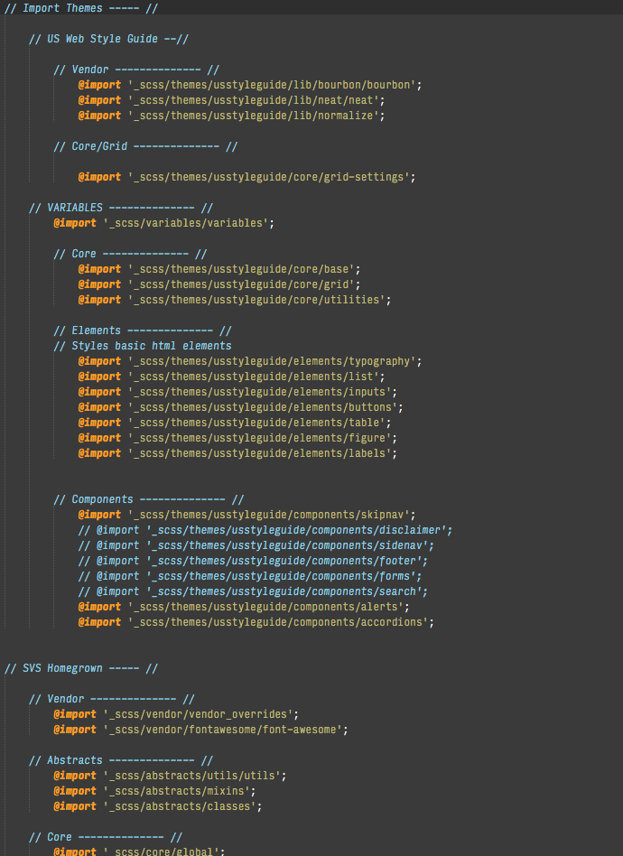
7-1 Pattern
base/
components/
layout/
pages/
themes/
abstracts/
vendors/

Slide 22
SVS Adaption: We don’t use pages/ and the US Style Guide is located in themes/

Slide 23
Class Naming

Slide 24
Be descriptive – not prescriptive – to keep the focus on modularization

Slide 25
Prescriptive: .list-no-styles .box-with-shadow

Slide 26
Descriptive: .main-menu .callout-box

Slide 27
Descriptive class names and thoughtful comments go hand-in-hand. More on this later…

Slide 28
Context-dependent children should inherit the parent’s naming as a prefix to contextualize context-specific classes

Slide 29

Contextualize Content-Specific Classes
.thing { }
.thing-heading { }
.thing-heading-button { }

Slide 30
Think Modularly: Think about what aspects of a thing might be (or become) variable, and style them as such

Slide 31
Recognize Variations
/* It's always padded nicely, and bold... */
.button {
display: inline-block;
padding: 0.5em 1em;
font-weight: bold;
}

Slide 32
Recognize Variations
/* ...but sometimes it's red... */
.button-red {
background: red;
color: white;
}

Slide 33
Recognize Variations
/* ...and sometimes blue. */
.button-blue {
background: lightblue;
color: darkblue;
}

Slide 34
Style Basic Elements First: CSS provides exceptions to rules, not the rule itself

Slide 35
Style Basic Elements First: Bad Example
ul {
list-style: none;
margin: 0;
padding: 0;
/* Yay, now my nav menu doesn't need this! */
}

Slide 36
Style Basic Elements First: Bad Example
.main-section ul {
list-style: disc;
margin: 1em 0;
padding: 0 0 0 1em;
/* Oh. Now I'll undo that initial reset so these lists
actually look like lists. And remember to put a .main-section div
on every page where I want lists to look like lists. */
}

Slide 37
Style Basic Elements First: Good Example
ul {
list-style: disc;
margin: 1em 0;
padding: 0 0 0 1em;
/* Lists are lists */
}

Slide 38
Style Basic Elements First: Good Example
.nav-menu {
list-style: none;
margin: 0;
padding: 0;
/* The thing that’s not really a list gets the
special reset styling */
}

Slide 39
Keeping key selectors specific.

Slide 40
The more general your key selector, the more likely it is that future code changes will be erroneously affected.

Slide 41
Specific Selectors: Bad Example
.thing span {
color: orange;
/* Is it orange because it’s in a span? */
}

Slide 42
Specific Selectors: Good Example
.thing-accent {
color: orange;
/* Or is it orange because it’s an accent in
.thing? */
}

Slide 43
Nesting

Slide 44
Avoid unnecessary nesting. The more specific your key selector, the more likely it is that it can stand on its own.

Slide 45
Nesting: Bad Example
.thing {
.thing-heading {
.thing-heading-accent {
/* . . . */
}
}
}

Slide 46
Nesting: Good Example
.thing { }
.thing-heading { }
.thing-accent { }

Slide 47
Mind the depth. Try to keep things no more than 4 levels deep, including pseudo-selectors (:before, :hover, etc.)

Slide 48
.nav-menu {
> li {
> a {
&:hover {
}
}
}
ul {
li {
}
ul {
li {
/* Where am I? Who are you? */
}
}
}
}

Slide 49
Syntax

Slide 50
Use new lines to keep code readable.

Slide 51
New Lines: Bad Example
.thing, .other-thing {
background: blue; color: red;
}

Slide 52
New Lines: Good Example
.thing,
.other-thing {
background: blue;
color: red;
}

Slide 53
Keep all element rules before nested children to keep properties close to their selector.

Slide 54
Ordering: Bad Example
.thing {
position: absolute;
top: 7px;
left: 0;
.thing-child {
/* . . . */
}
background: red;
}

Slide 55
Ordering: Good Example
.thing {
position: absolute;
top: 7px;
left: 0;
background: red;
.thing-child {
/* . . . */
}
}

Slide 56
Make sure your future self knows what the heck your current self was thinking when you made that z-index: 743.

Slide 57
But, future-you knows how to read code too.

Slide 58
Comments: Bad Example
.thing {
color: blue; // Make it blue
font-weight: bold; // Bold
z-index: 743;
}

Slide 59
Comments: Good Example
.thing {
color: blue;
font-weight: bold;
z-index: 743; // Tuck between sticky header at 740 and overlay at 745
}

Slide 60
The code should tell you how, the comments should tell you why.

Slide 61
Never use !important

Slide 62
Think long and hard before using !important. It can easily wreak havoc on a codebase, and make debugging CSS issues a nightmare.

Slide 63
Once there’s one !important, you’ll inevitably have to add more.

Slide 64
Going Beyond ‘It Works’

Slide 65
Beyond ‘It Works’
Keep things DRY
Check to see if a style has already been written
Utilize the power of SASS (specifically variables and mixins)
Think twice about the importance of using !important
Code tells you how, comments tell you why

Slide 66
Beyond ‘It Works’
Name Things for Reuse
Consistency: Naming Selectors
Choose either .camelCase, .hyphened-selectors, or .underscored_selectors (limit a mixture of more than two)
For SVS, we’ll stick to .hyphened-selectors as much as possible (use discretion when using underscores, but don’t use camelCases)
Reason: US Style Guide primarily hyphenates their selectors.

Slide 67
Resources
CSS Tricks (https://css-tricks.com/)
Sass Guidelines (http://sass-guidelin.es/)
Can I Use? (http://caniuse.com/)
SitePoint (http://www.sitepoint.com/html-css/)

Slide 68
Questions?

